Slide 1


Leadership Coaching
for Leaders
of XYZ Company
Transforming leaders for their next level
of performance, building stronger teams,
and creating higher impact for organizations
Taylor Lee, Leadership Coach

Slide 2



Getting to know XYZ Company
01
What is your experience with Leadership Coaching so far?
Coaching for
Leadership Development
02
Why are you interested in Leadership Coaching at this point in time?
03
How would you ideally want to use Leadership Coaching in your organization?

Slide 3
Getting to know XYZ Company
04
What results & benefits do you expect?
Coaching for
Leadership Development
05
Do you want results to be measurable and guaranteed?

Slide 4

01
What are the main leadership culture and behavioral issues that you like to address in your organization?
Getting to know XYZ Company
02
Using leadership coaching
to improve the effectiveness
of your leaders
What has your organization done over the last three years to address this?
03
Have you followed up to measure if & how leaders have become measurably more effective as a result of that?

Slide 5
01
What are the main leadership culture and behavioral issues that you like to address in your organization?
Getting to know XYZ Company
04
Using leadership coaching
to improve the effectiveness
of your leaders
How valuable would it be for your business performance if your leaders would be measurably more effective in the behaviors you just mentioned?
05
If we could guarantee to measurably grow leaders to be consistently more effective in these behaviors would that be of value to you?

Slide 6
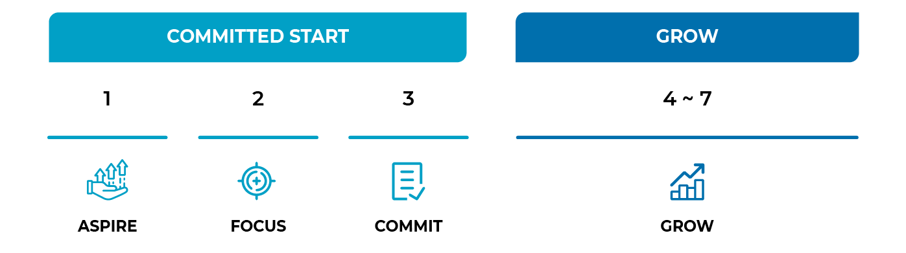
Two main approaches to leadership coaching
  Conventional: Leader and Coach
  Holistic: Leader and Coach, with the Leader involving their coworkers (360 Feedforward Coaching)

Slide 7
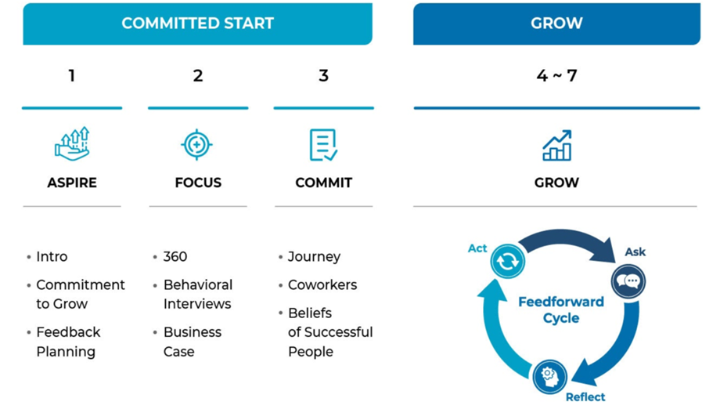
360 Feedforward
Coaching
Committed Start
The coach works with the leader to select 2 high-value areas for growth that are important to them and the organization.
Once the leader has committed to which behaviors to improve and selected the relevant coworkers to support them in their development journey, alignment with and confirmation from the manager is next.

Slide 8
360 Feedforward Coaching
Grow
Ask for future-focused suggestions to improve in your growth areas (don't forget to thank people for their valuable input!)
Reflect on the suggestions given and create a monthly action plan
Act on the suggestions given by sharing and implementing the action plan (remember to follow up with coworkers to check whether the change is visible to them)

Slide 9



Why Involve Coworkers?
Two Things To Consider
01
Who decides if a leader is effective?
The leader or their coworkers?
The coworkers’ perception is the leader’s reality.
02
95% of leaders who involve coworkers in their leadership development get better

Slide 10

Coworkers' perception of a leader is the reality of where the leader stands

Slide 11

95% of leaders who involve coworkers in their leadership development measurably improve in their leadership effectiveness
60%
40%
20%
Research of 86,000 respondents on 4 continents
0%
-3
-2
-1
0
1
2
3

Slide 12

Questions?
Taylor Lee, Leadership Coach
Global Coach Group
Lead for Good
www.globalcoachgroup.com

